Slide 1
EMPLOYEE DATA ANALYSIS USING EXCEL
STUDENT NAME: VARSHINI BS NAAN MUDIHALVAN ID:ASUNM1363422200525 REGISTER NO:422200525 DEPARTMENT:B.COM(ISM) COLLEGE: VALLIAMMAL COLLEGE FOR WOMEN

Slide 2
PROJECT TITLE
MALE AND FEMALE EMPLOYEE COUNT ANALYSIS IN EACH DEPARTMENT

Slide 3
AGENDA
Problem Statement Project Overview End Users Our Solution and Proposition Dataset Description Modelling Approach Result and Discussion Conclusion

Slide 4
PROBLEM STATEMENT
Analysis to measure the performance of male and female employees from a dataset using excel

Slide 5
PROJECT OVERVIEW
In this presentation we are going to see what are the features and techniques used in the excel to remove null values.error values, to create a summary and to visualize a data in a easy method.

Slide 6
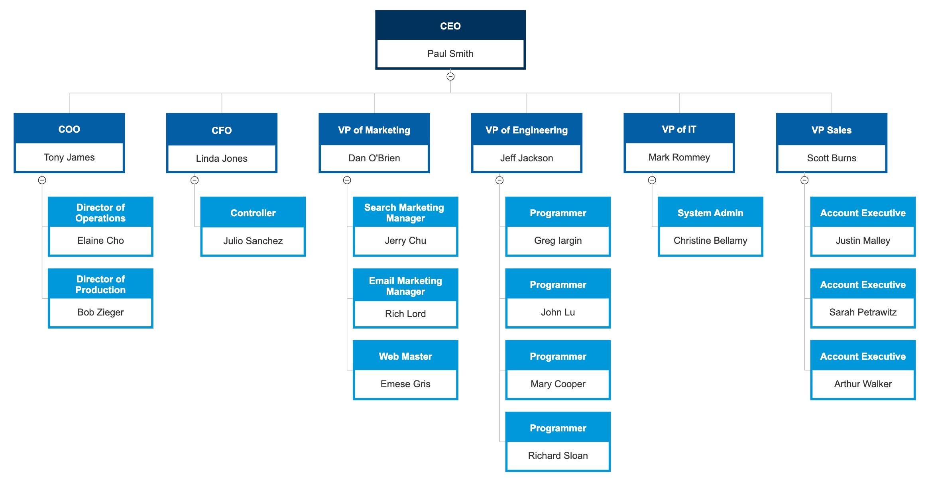
END USERS

Slide 7
OUR SOLUTIONS AND PROPOSITION
FILTERING: The filtering feature is used to remove the missing values from the excel CONDITIONAL FORMATTING: Conditional formatting is used to highlight the blank values from excel PIVOT TABLE: Pivot table is used to view the summary of the whole excel data

Slide 8
DATASET DESCRIPTION
EMPLOYEE DATASET-This dataset is taken from edunet dashboard It has 26 features From that I have taken 11 features EMPLOYEE ID –Text Type Data FIRST NAME-Text Type Data LAST NAME Text Type Data BUSINESS UNIT-Text Type Data

Slide 9
DATASET DESCRIPTION
EMPLOYEE STATUS-Text Type Data PAY ZONE –Text Type Data DEPARTMENT TYPE Text Type Data GENDER CODE-Text Type Data PERFORMANCE SCORE-Text Type Data CURRENT EMPLOYEE RATING Numeric Data
PERFORMANCE LEVEL Text Type Data

Slide 10
THE “WOW” IN OUR SOLUTION
The wow solution is used in performance level to convert the numeric value of current employee rating into text data FORMULA: =IFS(Z2>=5,”VERYHIGH”,Z2>=4,”HIGH”, Z2>=3,”MEDIUM”, TRUE,”LOW”)

Slide 11
MODELLING APPROACH
DATA COLLECTION: This dataset is collected from the naan mudhalvan edunet dashboard FEATURES: It has totally 26 features From that I have taken 11 features DATA CLEANING: Conditional formatting is used to highlight balnk values Filtering is used to filter missing and null values

Slide 12
MODELLING APPROACH
PERFORMANCE LEVEL: VERY HIGH,HIGH, MEDIUM,LOW PIVOT TABLE: Business Unit Performance Level Gender Code Pay Zone

Slide 13
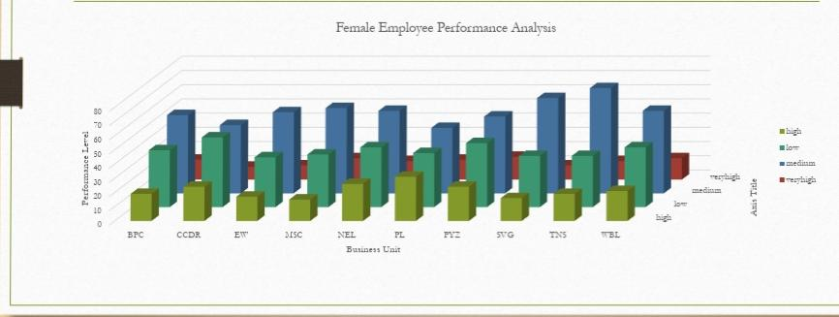
RESULTS AND DISCUSSION

Slide 14
CONCLUSION
Using excel features like conditional formatting.filtering.pivot table.charts I have removed null and blank values, highlighted cells.got the summary of the whole data and created a chart to visulazie the data in a simple and easiest way. There are so many others features in excel,with excel we can make our big datas into easy visualization and it will make us understand the data easy.

Slide 15
THANK YOU

